Slide 1
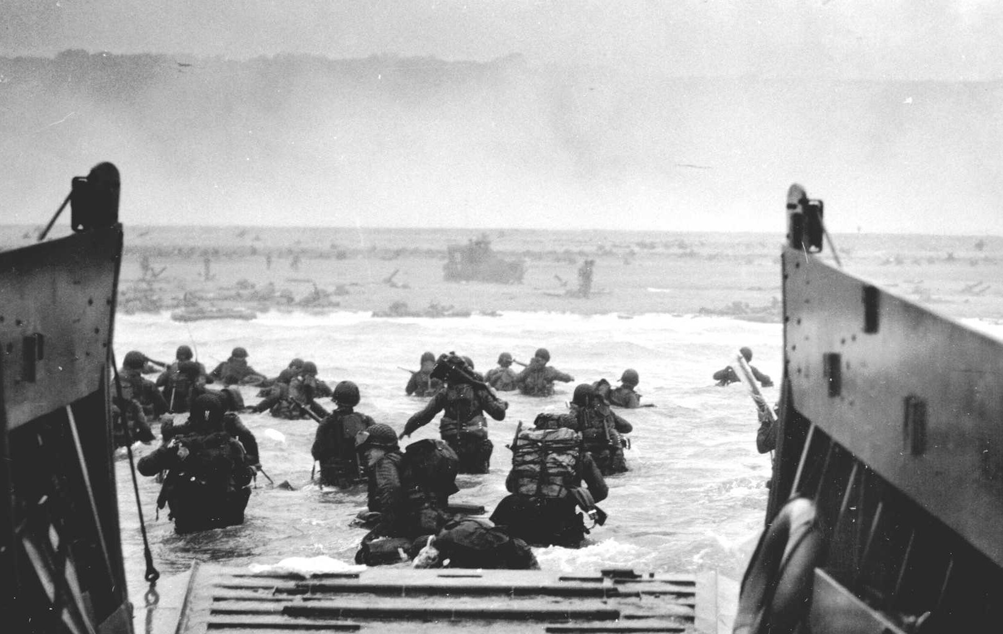
D-Day
Attack on Normandy Beaches and the beginning of the end of World war ii

Slide 2
Background
France had been occupied by Germany since 1940
There were resistance movements in France against Germany
The Allied Powers (Britain, U.S., Canada) had been planning for D-Day since 1943
Hitler was nervous about possible attacks on the coast of France, so ordered General Rommel to construct fortifications along the beaches of Normandy
Rommel ordered wooden stakes, metal tripods, mines, anti-tank obstacles, barbed wire, and booby traps on the coast of Normandy
Very hazardous for Allied troops

Slide 3
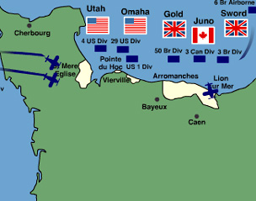
Planning for d-day
Planning began in 1943
Since it was a seaborne invasion, the tide, moon, and time of day had to be planned for, and meant that only a few days a month were acceptable for the invasion
Target was 50 miles of beach in Normandy, France

Slide 4
In the early morning….
At midnight, 24,000 American, British, and French airborne troops landed in the English Channel
At 6:30 am, the troops began the invasion of Normandy beaches
There were unexpected strong winds that day so boats were pushed east of intended landing areas, which caused more death, particularly for Omaha and Utah beaches
Men landed on beach with heavy artillery fire coming from cliffs above

Slide 5
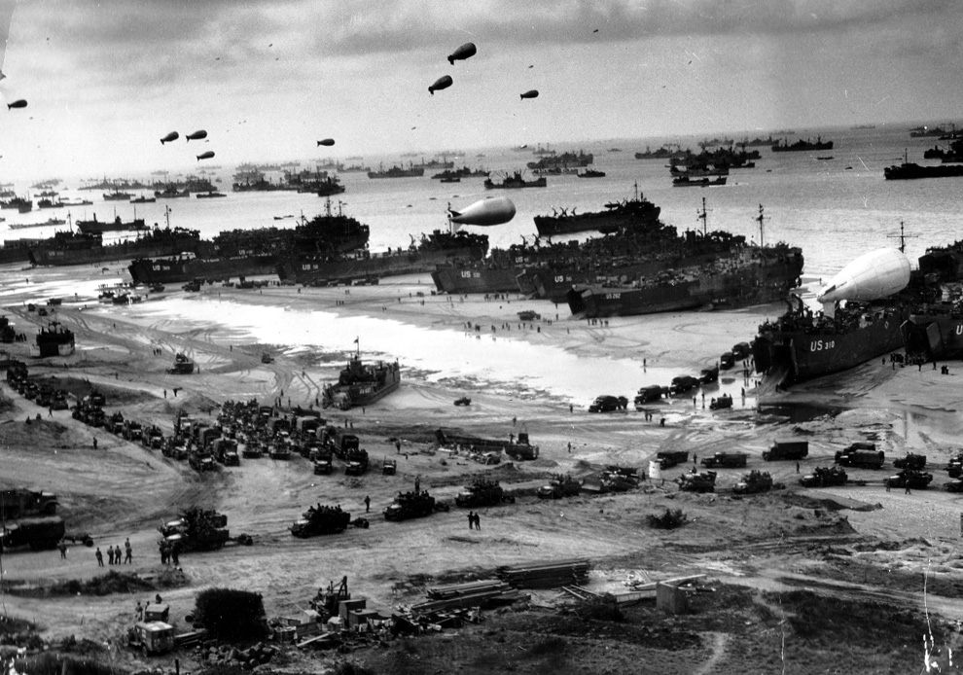
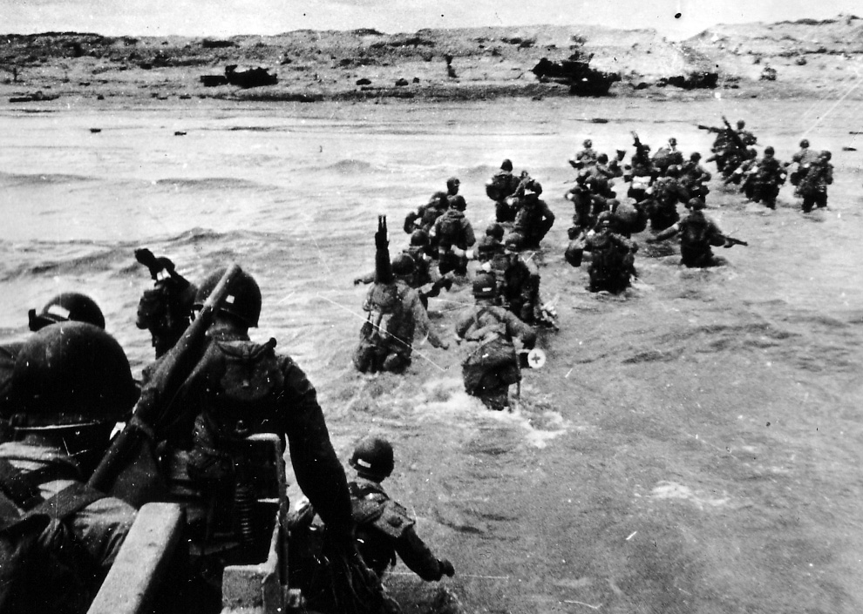
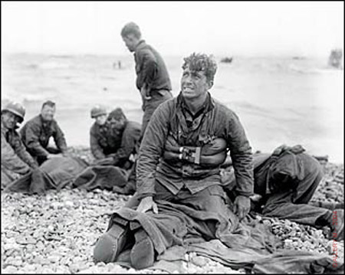
Pictures from D-Day

Slide 6
Omaha beach
Most heavily defended beach by German troops
Composed of 1st and 29th division of American troops
Many boats ran aground on sandbars, so troops had to wade in almost 100 feet of water to get to the beach, were heavily exposed to artillery fire from cliffs above
Casualties for Omaha beach were almost 5,000 killed (half of the total casualties)
By the end of the day Omaha beach was in American hands
https://www.youtube.com/watch?v=_cytrCXTHno

Slide 7
Aftermath
British forces had coordinated an attack with the French resistance. That day, the resistance sabotaged the rail system, electric system, and sent additional troops to the beaches
On D-Day alone, there were 1,000 German casualties and 10,000 Allied casualties
D-Day failed to achieve everything they had set out to do, but did gain a foothold in France that was expanded over the coming months
By the end of June, 875,000 men had disembarked on the beaches
Major turning point in WWII, after this invasion the Allies began to reclaim Europe from the Axis Powers
http://commons.wikimedia.org/wiki/File:Second_world_war_europe_animation_small.gif

Slide 8
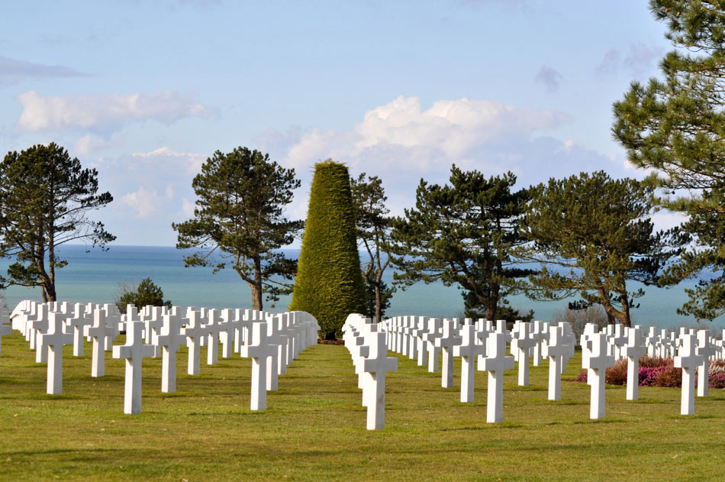
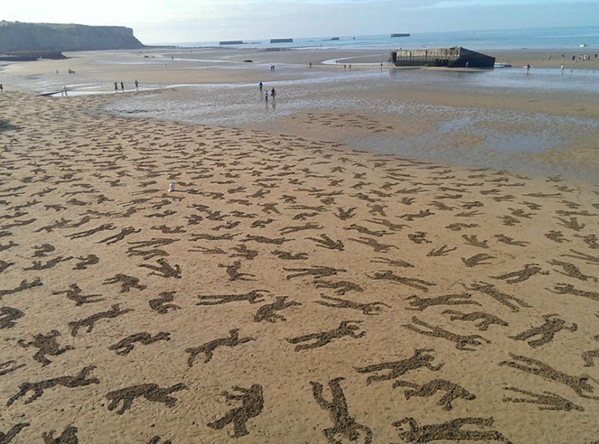
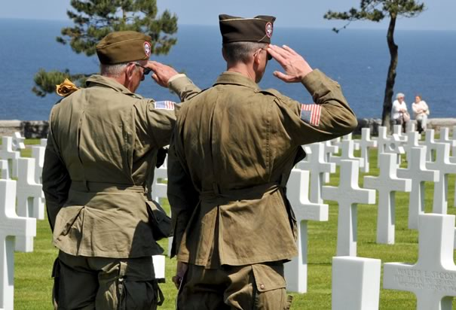
The site today

